Slide 1
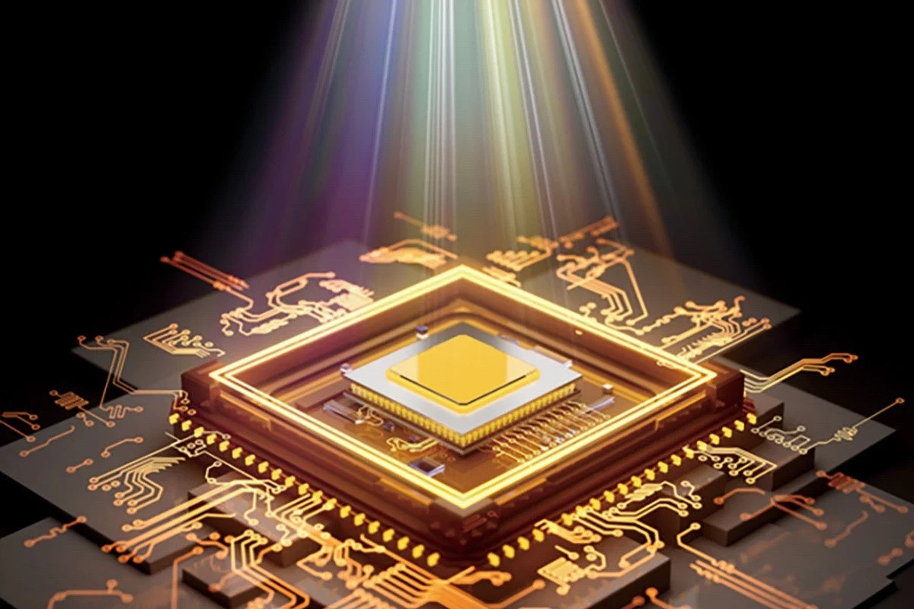

Digital System Design
16-BIT SINGLE CYCLE PROCESSOR
TRƯƠNG
BD
BỬU DUY

Slide 2

TRƯƠNG
CONTENT
BD
BỬU DUY
Overview
1
Testing
2
CONCLUSION
3

Slide 3
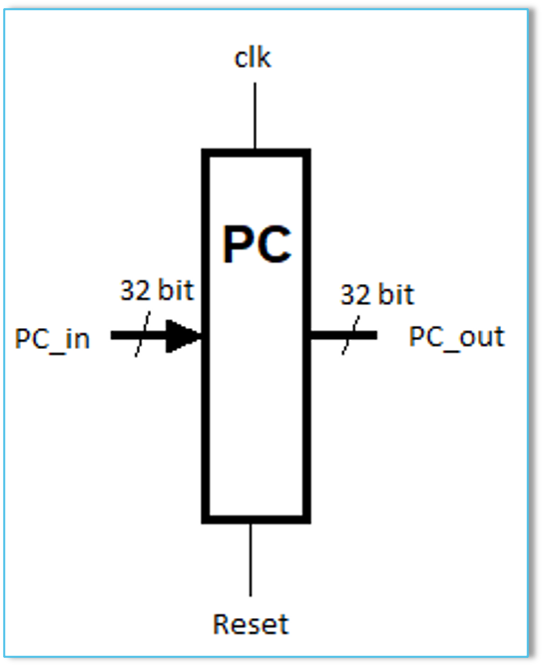
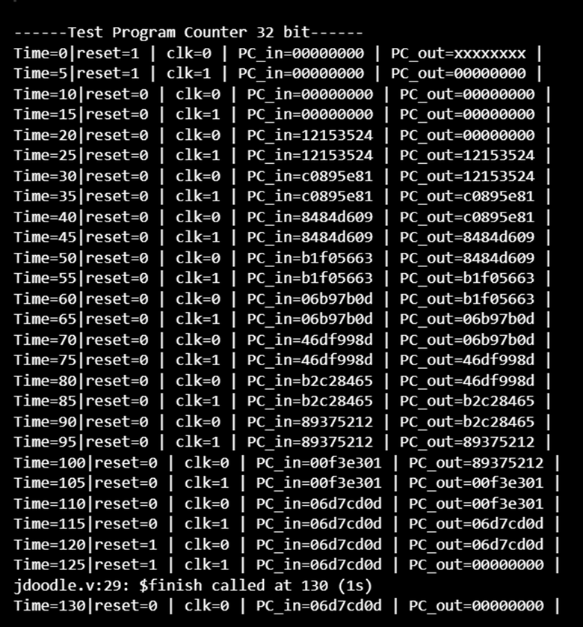
OVERVIEW
Program Counter Module

Slide 4
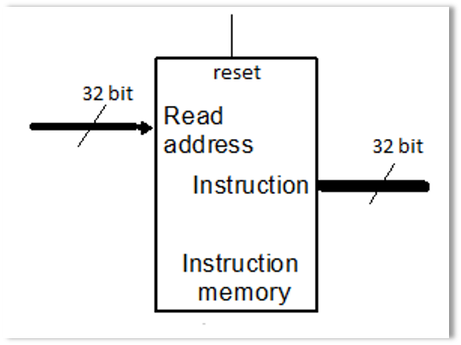
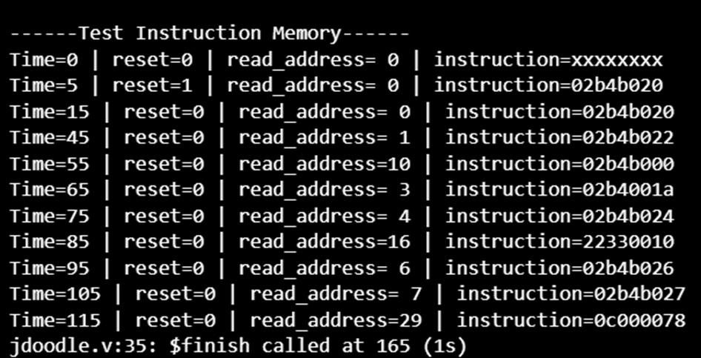
OVERVIEW
Instruction Memory Module

Slide 5
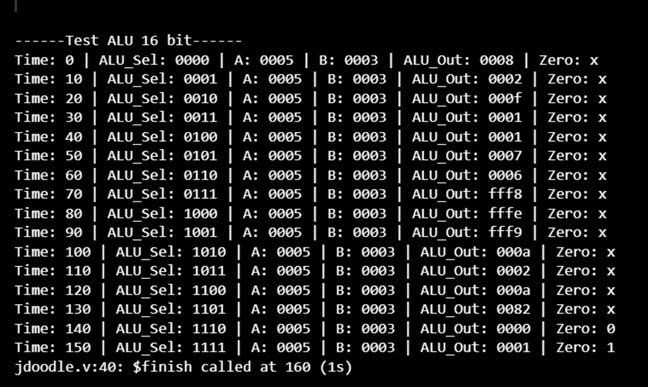
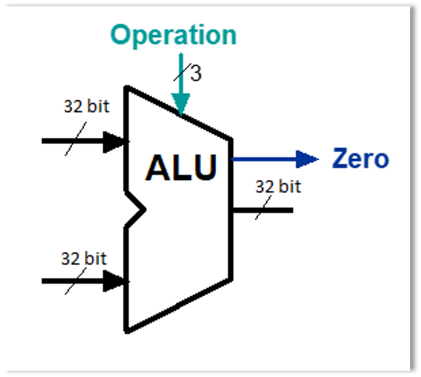
OVERVIEW
ALU Module

Slide 6
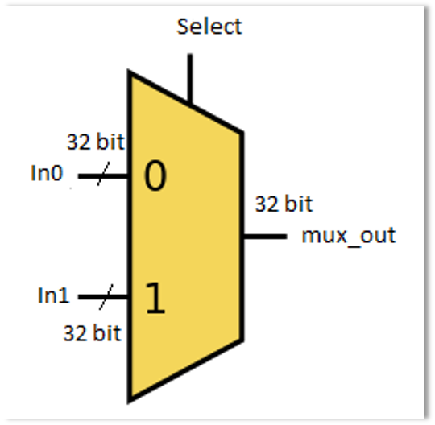
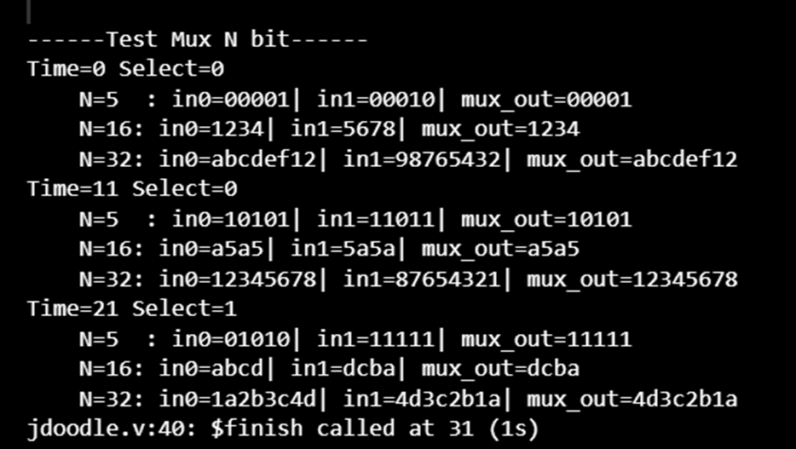
OVERVIEW
Mux Module

Slide 7
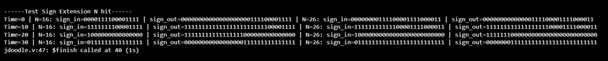
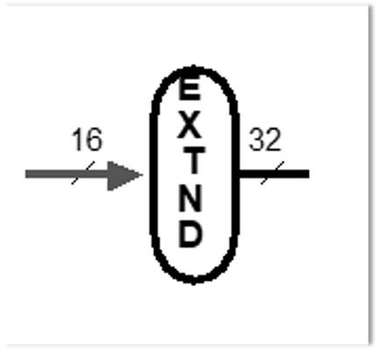
OVERVIEW
Sign Extend Module

Slide 8
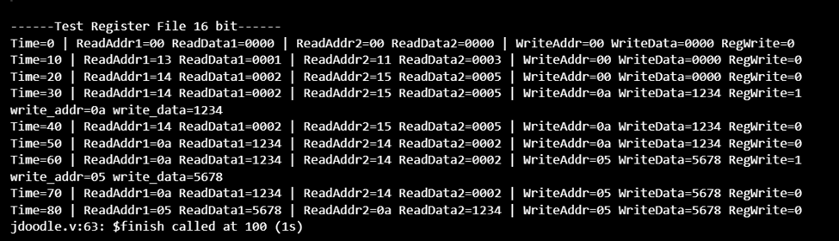
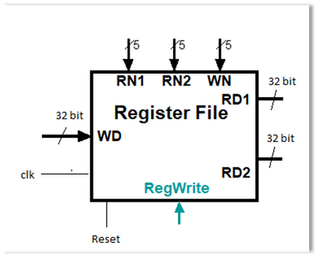
OVERVIEW
Register File Module

Slide 9
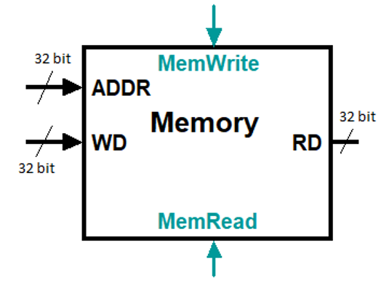
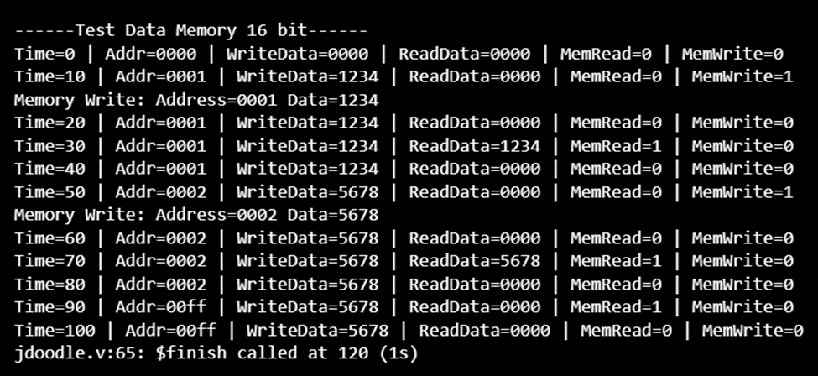
OVERVIEW
Data Memory Module

Slide 10
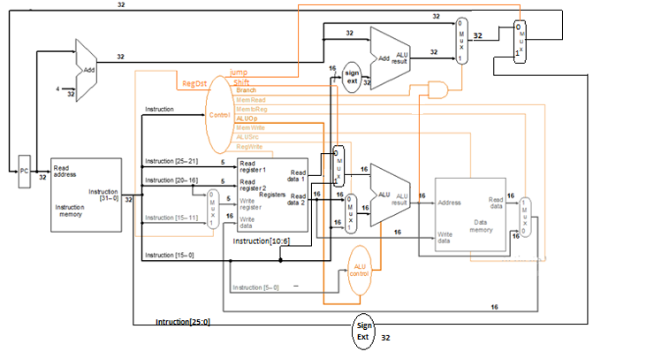
TESTING
Schematic

Slide 11
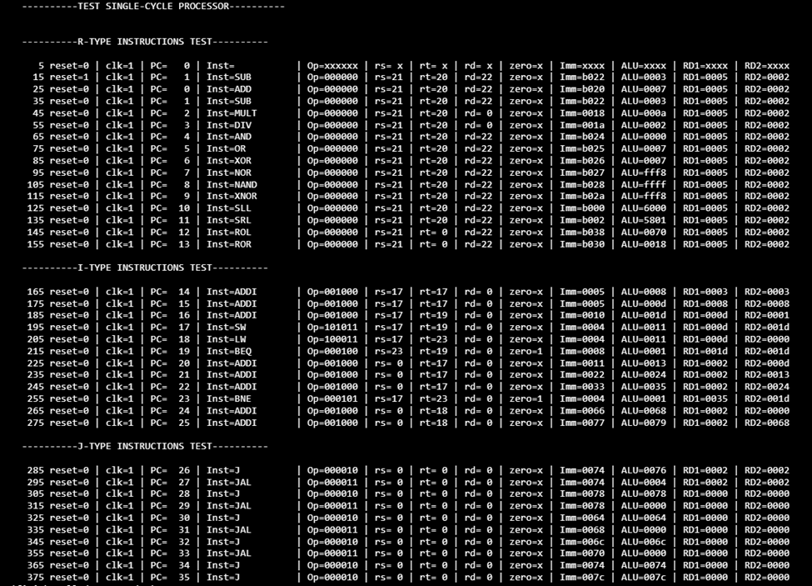

Slide 12
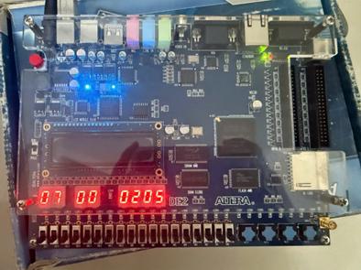
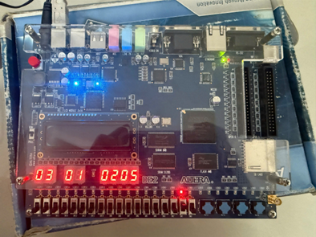
R-Type

Slide 13
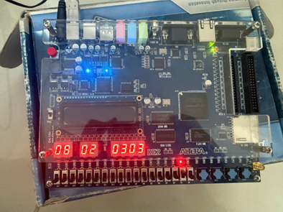
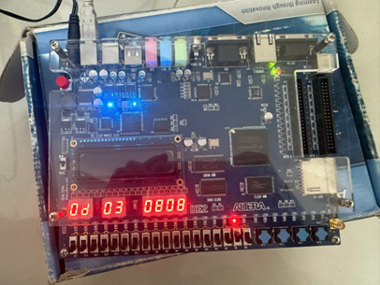
I-Type

Slide 14
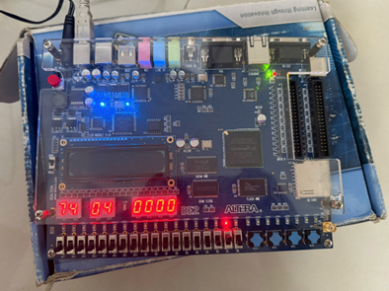
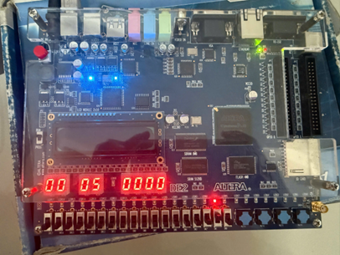
J-Type

Slide 15
CONCLUSION
Mostly completed.
Meets the project requirements.
Tested on FPGA.
Ongoing work: Implementing debouncing for the swing on FPGA.

Slide 16
THANKS FOR LISTENING

